Slide 1
Predicting Retail Sales Channels
A comparative machine-learning study on multi-channel footwear retail data , benchmarking the transaction patterns.
Name: Suvankar Das
PRN: 25060242146

Slide 2
CONTENTS
01
Introduction
02
Objectives
03
Dataset Description
04
ML Model & Relevance
05
Orange Workflow
06
Results
07
Future Scope
08
References

Slide 3

Introduction
The global footwear and apparel retail industry operates across dynamic multi-channel distribution networks: in-store locations, factory outlets, and online e-commerce platforms.
Understanding how product line, pricing, region, and distribution partner influence transaction outcomes is central to optimizing these channels.
This project analyzes a consolidated, brand-unbiased retail dataset of 18,997 transactional records, applying K-Nearest Neighbors (KNN) and Naïve Bayes in Orange Data Mining to predict the fulfilment channel (Sales Method) and overall transaction revenue (Total Sales).
Problem Statement: Given a retail transaction's price, volume, retailer, and region, can we
accurately predict whether it was fulfilled Online, In-Store, or at an Outlet and does this predictive relationship hold consistently across competing brands (Nike vs Adidas)? This project uses K-Nearest Neighbors and Naive Bayes to answer this, and evaluates which model and configuration best supports channel-level operational decision-making.

Slide 4
Objectives
Predictive Modelling & Classification
1
Train and evaluate KNN and Naive Bayes in Orange to classify Sales Method, benchmarked on Accuracy, F1-Score, Precision and Recall.
Revenue Tiers & Pattern Discovery
2
Use continuous attributes : Price per Unit and Units Sold to understand what drives higher sales volume via clustering and distribution analysis.
Cross-Retailer Comparative Analysis
3
Apply the same algorithm to Nike and Adidas independently and compare model performance across two competitors in the same market.

Slide 5
Dataset Description
18,997 observations across 9 structured attributes capturing multi-channel footwear retail operations across the United States. Datasets:Adidas_Sales.csv, Nike_Sales.csv
Attribute | Type | Description
Sales Method | Target (categorical) | Fulfilment channel : Online, Outlet, or In-Store
Total Sales | Continuous | Revenue generated per transaction (USD)
Price per Unit | Continuous | Selling price per item : $7 to $110
Units Sold | Continuous | Quantity of item pairs sold per transaction : 0 to 1,275
Product | Categorical (6 levels) | Men's / Women's Street & Athletic Footwear, Apparel
Retailer | Categorical (6 levels) | Foot Locker, West Gear, Sports Direct, Kohl's, Amazon, Walmart
Region / State | Categorical | 5 US regions, granular state-level location
Invoice Date | Identifier | Purchase chronology timestamp

Slide 6
Data Cleaning Process
1
2
3
Header Normalization
Column Alignment
Revenue Recalculation
Standardized all column names to Title Case to resolve casing inconsistencies.
Dropped Adidas-only operational columns (sales_id, retailer_id, city, operating profit/margin) to match Nike's 9-column schema.
Recomputed Total Sales = Price per Unit × Units Sold to correct miscalculated rows.
4
5
4
Text Standardization
Data Consolidation
Stripped whitespace and normalized text casing across categorical features.
Merged Nike (9,360 rows) and Adidas (9,637 rows) into 18,997 complete records with zero missing values.

Slide 7
Machine Learning Model : K-Nearest Neighbors (KNN)
Local Feature Clustering
Distance Metric
Adidas transactions form distinct spatial clusters on Price per Unit and Units Sold; KNN uses distance metrics to locate transactions with similar pricing and volume profiles within the 9,637-record Adidas dataset.
Euclidean distance between a query record x and training instance y across n normalized numeric predictors:
Non-Parametric Flexibility
d(x,y) = √ Σ(xᵢ − yᵢ)²
Makes no assumption about the statistical distribution of the data — robust against the skewed Online/Outlet/In-Store sales split observed in the Adidas dataset.
Classification Rule
Assign the class most frequent among the k nearest neighbours (majority vote). k = 3, 5, 7 tuned via cross-validation to balance bias and variance; k = 5 used for reported results.
Instance-Based Learning
Stores all training instances and computes class probabilities locally at prediction time, rather than fitting one global function.

Slide 8
Machine Learning Model : Why KNN Fits the Adidas Dataset ?
Why KNN Fits Adidas Specifically
Distance Metric
Adidas transactions cluster tightly by retailer and region : Foot Locker, Kohl's, and Amazon show distinct Price-per-Unit and Units-Sold signatures that KNN's distance-based grouping captures directly.
The Sales Method target (Online, Outlet, In-Store) is not linearly separable from Price and Units Sold alone; KNN's local, non-linear decision boundary adapts far better than a single global rule.
With 9,637 labelled Adidas transactions, KNN has enough neighbour density per class to keep local estimates stable, avoiding the sparse-neighbourhood problem that hurts KNN on small datasets.
d(x,y) = √Σ(xᵢ − yᵢ)²
Why k = 10 on Adidas
Cross-validated accuracy on the Adidas split peaks at k = 10.
Features used: Price per Unit, Units Sold, Retailer, and Region (normalized) · Result: KNN reaches 81.0% accuracy (F1 = 0.810) on the Adidas Sales Method target at k = 10.

Slide 9
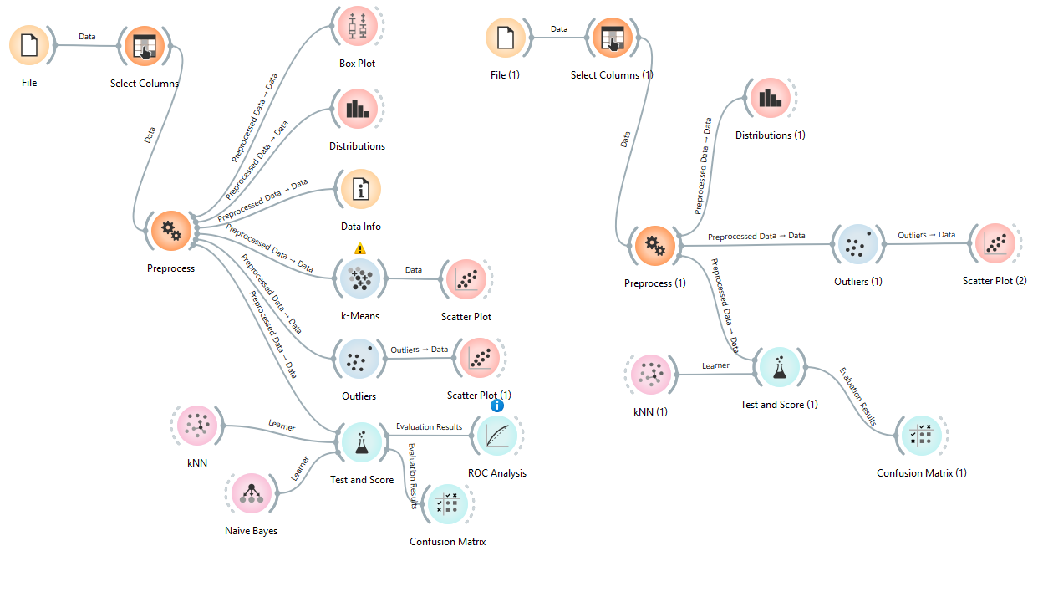
Orange Workflow
Two parallel pipelines process the Adidas and Nike datasets independently before results are compared. The File attached (Assignment Flow.ows)
Data Info
File
(Nike CSV)

Slide 10
Results : Data Visualisation
Distributions
Frequency of transactions by Sales Method, revealing the natural class imbalance (Online > Outlet > In-Store) that Test & Score must account for.
Box Plot
Spread and median of Total Sales per retailer, exposing revenue variance and high-value outlier transactions per brand.
Scatter Plot
Price per Unit vs Units Sold, coloured by Sales Method ,visualises the local clusters that KNN's distance metric exploits.
Outliers Widget
Flags transactions that deviate sharply in price/volume combination, informing whether extreme records should be capped before modelling.
k-Means → Scatter
Unsupervised grouping (k = 3) over the same numeric features, checked against Sales Method labels for alignment.

Slide 11
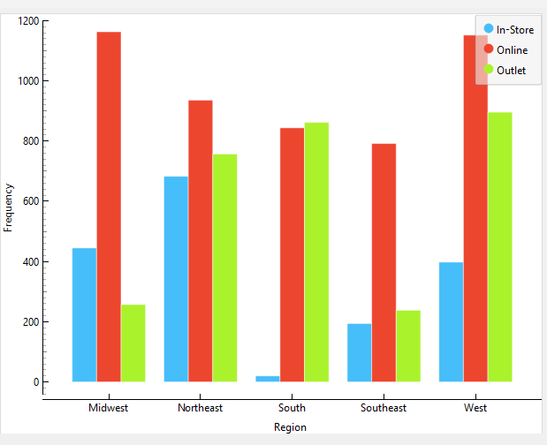

Results : Visualisation Output
Sales Method Distribution
The chart shows Sales Method distribution broken down by region.
Online is clearly the dominant channel in most regions: Midwest, Northeast, and West all show it as the tallest bar by a wide margin.
The South stands out as an anomaly: In-Store sales are almost negligible there, while Online and Outlet are nearly equal and both dominant, suggesting this region relies on a very different retail footprint compared to the rest.
In-Store remains the smallest channel across every single region, reinforcing that it's the minority fulfilment method overall, while the balance between Online and Outlet varies more noticeably from region to region : West and Midwest lean heavily toward Online over Outlet, whereas South and Southeast show the two channels much closer together.
The most operationally significant takeaway is the South's near-total absence of In-Store activity, which is worth highlighting separately since it breaks the pattern seen everywhere else.
Paste Orange screenshot here

Slide 12
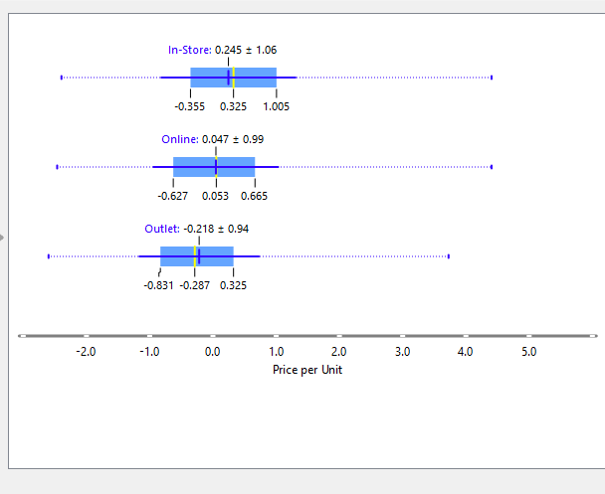
Box Plot
This box plot compares standardized Price per Unit across the three sales methods.
In-Store has the highest average price at 0.245 ± 1.06, meaning transactions fulfilled in physical stores tend to involve higher-priced items compared to the other two channels.
Online sits close to the overall mean at 0.047 ± 0.99, essentially neutral, neither skewing toward premium nor discount pricing. Outlet shows the lowest average price at -0.218 ± 0.94, which makes intuitive sense outlet channels are typically used for clearance and discounted stock, so lower price points there align with real-world retail behavior.
The spread (standard deviation) is fairly similar across all three channels, roughly 0.94 to 1.06, so no channel shows dramatically more price variability than another the separation between channels is driven by the shift in central tendency rather than differences in consistency.
Overall, this confirms a clear pricing hierarchy: In-Store > Online > Outlet, which is exactly the kind of price-based signal that gives KNN's distance metric something meaningful to separate on when predicting Sales Method.

Slide 13
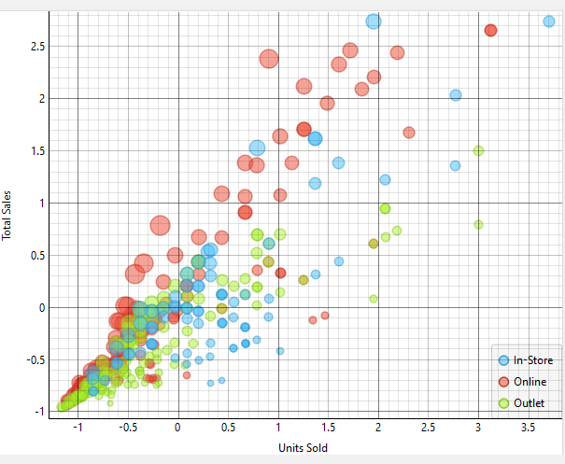
Price per unit and Units sold – Scatter Plot
This scatter plot shows Units Sold versus Total Sales (both standardized), colored by Sales Method, with bubble size likely reflecting Price per Unit.
As expected, there's a strong positive linear relationship more units sold naturally drives higher total sales, which follows directly from Total Sales being derived from Price × Units.
Online (red) transactions dominate the upper-right region, reaching the highest combinations of units sold and total revenue, confirming Online as the channel responsible for the largest, highest-value transactions.
In-Store (blue) points are more moderate and spread across the mid-range, with a few large-bubble outliers at lower volumes but higher per-unit price, consistent with the earlier finding that In-Store carries higher average pricing.
Outlet (green) transactions cluster most densely near the origin smaller units sold and lower total sales reinforcing that Outlet is the discount/clearance channel with lower-value transactions overall.
The clear separation of Online into the extreme high-volume, high-revenue zone, away from the denser Outlet and In-Store clusters near the origin, is exactly the kind of spatial separation KNN relies on when classifying Sales Method from these two features.

Slide 14
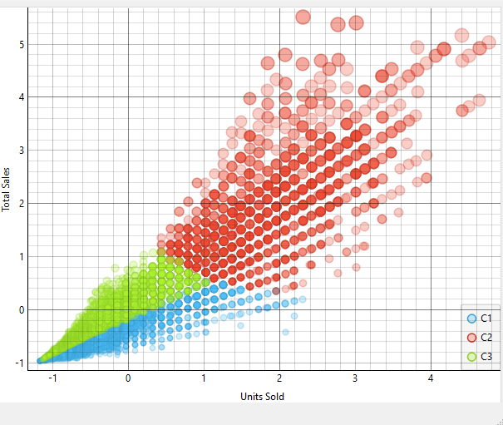
K-Means : Scatter Plot
This is the unsupervised k-Means output (k=3) applied to the same Units Sold vs Total Sales space used earlier.
Unlike the labeled Sales Method scatter, where Online, Outlet, and In-Store formed spatially separated groups, k-Means here produces three layered bands along the diagonal trend line rather than distinct channel-based clusters.
C2 (red) is the largest cluster, dominating the high units sold/high total sales region broadly similar in position to where Online sat in the labeled plot.
C1 (blue) occupies the lower band near the origin, while C3 (green) forms a thin middle layer between them.
The key takeaway is that k-Means clusters primarily by transaction magnitude grouping low, medium, and high volume/revenue transactions rather than by fulfilment channel, since it only sees the two numeric features and has no access to the actual Sales Method labels.
As a result, these unsupervised clusters overlap only partially with the true Online/Outlet/In-Store groupings.

Slide 15
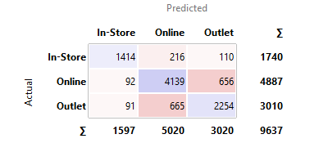
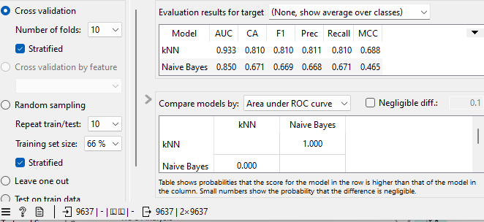
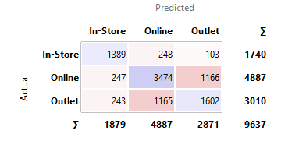
Results : Comparing KNN with Naive Bayes
Evaluation metrics from Orange's Test & Score widget, using the same Adidas training/test split for both models.
Confusion Matrix of both KNN and Naive Bayes
Accuracy: overall share of correctly classified transactions.
Precision: of predicted class instances, how many were correct.
Recall: of actual class instances, how many were found.
F1-Score: 2 × (Precision × Recall) / (Precision + Recall) , harmonic balance of the two.

Slide 16
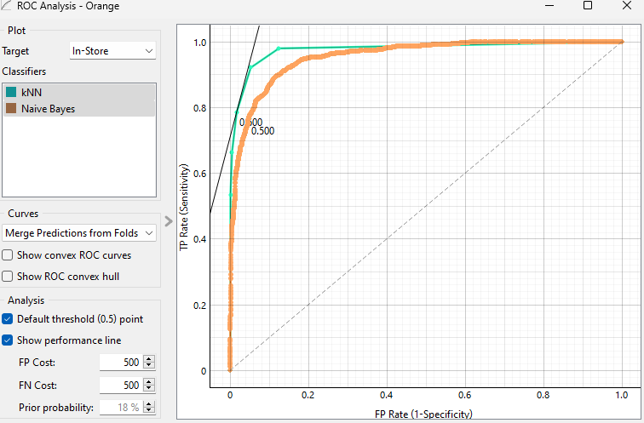
Interpretations: Based on Test & Score and Confusion Matrices
KNN outperforms Naive Bayes on every metric : AUC 0.933 vs. 0.850, Accuracy 81.0% vs. 67.1%, F1 0.810 vs. 0.669, MCC 0.688 vs. 0.465.
Confusion matrix confirms this: KNN correctly classifies 7,807/9,637 vs. Naive Bayes's 6,465/9,637.
Both models confuse Online ↔ Outlet most, but Naive Bayes is not fitted (2,331 vs. 1,321 mix-ups).
Naive Bayes's weakest class is Outlet — only 53% recall, near chance level.
Pairwise test: P(KNN > Naive Bayes) = 1.000 , the gap is statistically certain.
Hence, KNN is the stronger, statistically justified model for predicting Sales Method.
ROC Analysis

Slide 17
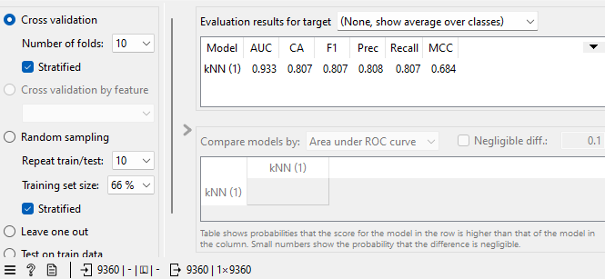
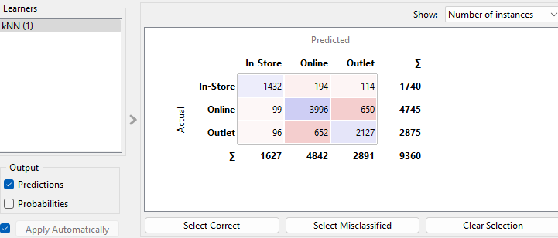
Results : Comparative Analysis- Adidas vs Nike
The same KNN configuration established on Adidas is applied independently to the Nike dataset and benchmarked against the Adidas result, testing whether the model generalises across competitors in the same market.
Nike Confusion Matrix
Similar accuracy across both brands would suggest pricing/volume patterns driving channel choice are structural to the footwear retail sector, not brand-specific.
A material gap would point to brand-specific channel strategy (e.g. one retailer leaning more heavily on outlet clearance) that the model picks up differently.

Slide 18
Interpretations: KNN Fit- Adidas vs Nike
KNN performs nearly identically on both brands AUC 0.933 (both), CA 81.0% (Adidas) vs. 80.7% (Nike), F1 0.810 vs. 0.807, MCC 0.688 vs. 0.684.
Confusion matrices show the same pattern in both: Online ↔ Outlet is the hardest boundary, In-Store is the cleanest class.
The gap between brands (<0.4 on every metric) is negligible well within normal fold-to-fold variation.
Hence, KNN generalizes consistently across both brands; classification performance is driven by the Online/Outlet channel overlap inherent to footwear retail, not by brand-specific pricing or region patterns , Adidas holds a marginal edge, but the model fits both datasets equally well.

Slide 19
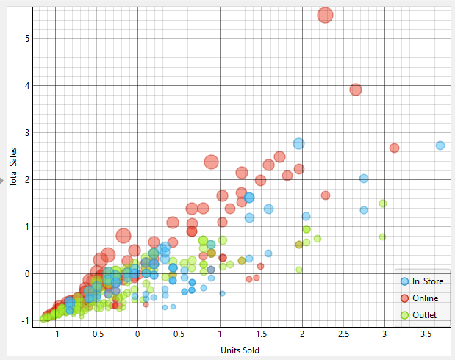
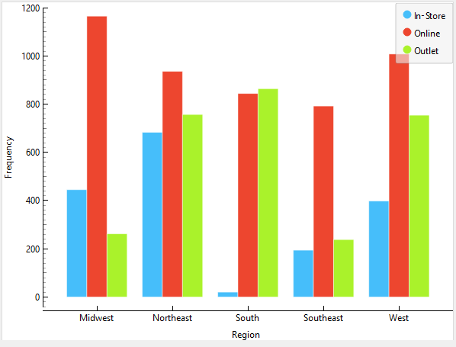
KNN Fit- Adidas vs Nike (Graphical)
Price vs Units Sold -- Scatter (Nike)
Sales Method Distribution (Nike)
Comparing the two brands' regional channel distributions reveals a striking consistency: Midwest, Northeast, South, and Southeast show nearly identical patterns across both Adidas and Nike , Online dominant in Midwest and Northeast, In-Store and Outlet roughly balanced but low, and the South anomaly (near-zero In-Store, Online/Outlet neck-and-neck) present in both brands.
The one region where the brands diverge is West , Adidas shows notably higher Online (1,150) and Outlet (890) volumes than Nike (1,010 and 750 respectively), suggesting Adidas has a stronger overall West-region presence or customer base, though the channel proportions remain similar.
This consistency across four of five regions is a strong signal: regional channel behavior appears to be a structural characteristic of the footwear retail market itself, not something driven by brand identity or strategy. It directly supports the earlier KNN generalization finding, since regional demand patterns are nearly brand-agnostic, it's unsurprising that a model trained on one brand's data transfers almost perfectly to the other.

Slide 20
Future Scope
Feature Expansion
Personalized Channel Recommendation
Incorporate Product category and State-level granularity as additional encoded predictors . Region and Retailer are already used, but finer product-type and state-level signals remain untapped and could sharpen channel prediction further.
Using the model's price/volume patterns to suggest the best-fit purchase channel to customers at checkout (e.g., "cheaper at your nearest Outlet" or "faster via Online"), improving customer experience beyond just internal operational planning.
Ensemble Methods
Time-Series Extension
Extend the comparison to Random Forest and Gradient Boosting for a stronger benchmark against KNN and Naïve Bayes.
Use of Invoice Date to model seasonal demand trends and forecast future Sales Method shifts.

Slide 21
References
Kaggle : Nike US Sales Dataset (Retail transactional records, 2020–2021).
1
Kaggle : Adidas US Sales Dataset (Retail transactional records, 2020–2021).
Orange Data Mining Toolkit - https://orangedatamining.com , visual programming for data analysis and machine learning.
5
6

